Slide 1
Six Tickets to Netiquette
Disusun oleh:
Bakhtiar (18304040004)
Zidan Dzulfikar As Sururi (183040028)
Ilyasa Ridho Tadzaka (183040013)

Slide 2

Think First Before Posting
https://www.harjasaputra.com/riset/pedoman-dalam-berinteraksi-di-dunia-maya-netiquette.html

Slide 3
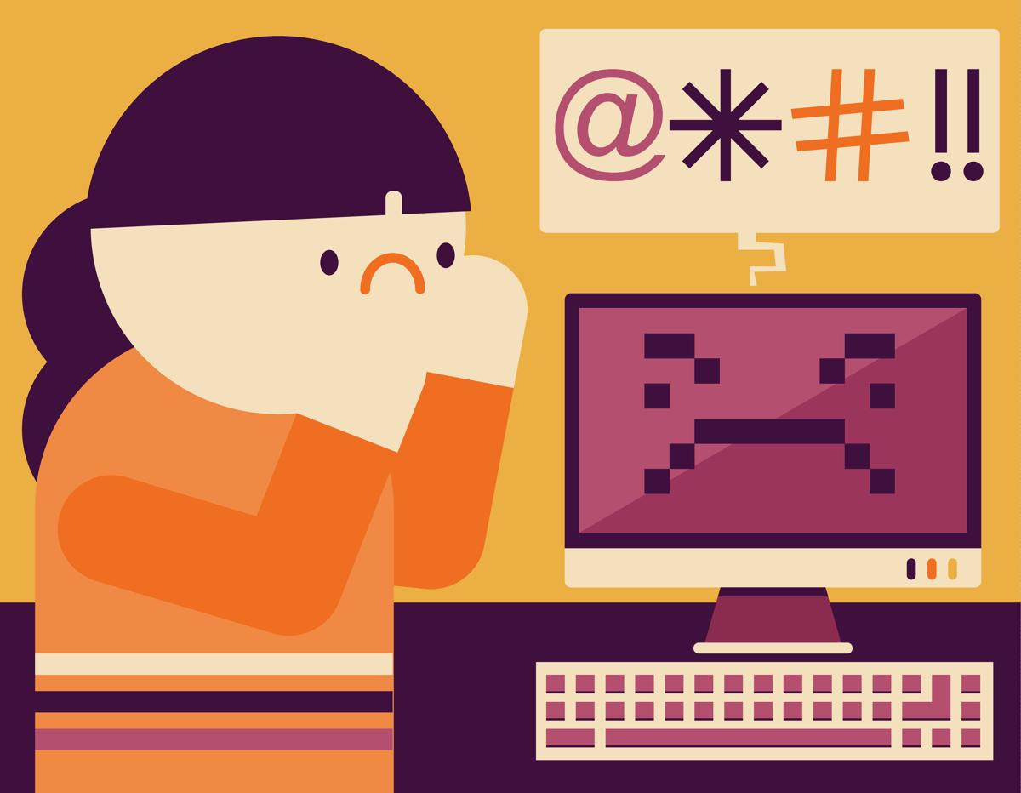
Avoid Flaming
https://www.harjasaputra.com/riset/pedoman-dalam-berinteraksi-di-dunia-maya-netiquette.html

Slide 4

Don’t Be Easily Offended
https://www.harjasaputra.com/riset/pedoman-dalam-berinteraksi-di-dunia-maya-netiquette.html

Slide 5

Avoid Patronizing Attitudes or Words
https://www.harjasaputra.com/riset/pedoman-dalam-berinteraksi-di-dunia-maya-netiquette.html

Slide 6

Know Your Audience
https://www.harjasaputra.com/riset/pedoman-dalam-berinteraksi-di-dunia-maya-netiquette.html

Slide 7

Forgive Other People’s Mistakes
https://www.harjasaputra.com/riset/pedoman-dalam-berinteraksi-di-dunia-maya-netiquette.html

Slide 8
Summary
https://www.harjasaputra.com/riset/pedoman-dalam-berinteraksi-di-dunia-maya-netiquette.html

Slide 9
Thank you
Referensi:
Scheuermann, Larry; Taylor, Gary, Netiquette, Jurnal Internet Research 7. 4 (1997): 269-273.
Shea, Virginia. Netiquette. Cornell Univ: Albio Publisher, 1994, digitized 2004.
Kelly, P. J. (1996), “Netiquette and Nethics” from Back to Netropolitan Life, Mind your Manners, available: http://www-home.calumet.yorku.a/pkelly/www/ nquette.htm
Brakeman, L. (1995), “E-mail Lists are the Ultimate Electronic Penpals, ” Managed Healthcare, Vol. 5, July, p. 50.
https://www.harjasaputra.com/riset/pedoman-dalam-berinteraksi-di-dunia-maya-netiquette.html

